Slide 1

Programming for Engineers
BEP2073
>> Slide 7.2
>> Data Science (Part 1)
Big data and real-world analytical solution

Slide 2

Course Learning Outcome
CLO1 | Outline the operational procedure of programming language.
CLO2 | Outline the object-oriented attribute in the programming flow.
CLO3 | Evaluate the program structure on function, branching and condition.
CLO4 | Develop a programming/syntax solution for chemical engineering case study.
CLO5 | Differentiate between solution error and syntax error for complex engineering case study

Slide 3





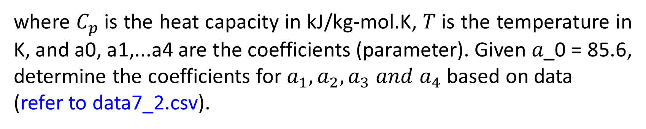


Exercise 1: Regression
The following data were gathered to determine the relationship between heat capacity and temperature of a Carbon disulfate, CS2. The temperature dependency of the heat capacities of gases is commonly represented by simple polynomials of the form:
$$C_{p}\left(T\right)=a_{0}+a_{1}T+a_{2}T^{2}+a_{3}T^{3}+a_{4}T^{4}$$
where $C_{p}$is the heat capacity in kJ/kg-mol.K, 𝑇 is the temperature in K, and a0, a1,...a4 are the coefficients (parameter). Given 𝑎_0 = 85.6, determine the coefficients for $a_{1},a_{2}, a_{3} and a_{4}$ based on data
(refer to data7_2.csv).

Slide 4



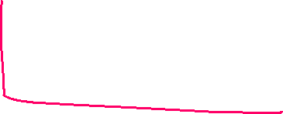





%clear
import pandas as pd
import matplotlib.pyplot as plt
import scipy.optimize as so
import numpy as np
Data = pd.read_csv (r'Data2.csv')
X = Data.x
Y = Data.y
plt.plot(X,Y,'.r')
plt.xlabel('X')
plt.ylabel('Y')
plt.grid()
plt.title('Get data from csv file by using Pandas')
def f(x,a1,a2,a3):
return a1*x + a2/x + a3*np.log(x)
a_sol, a_cov = so.curve_fit(f, X, Y)
[additional code]
$$C_{p}\left(T\right)=a_{0}+a_{1}T+a_{2}T^{2}+a_{3}T^{3}+a_{4}T^{4}$$

Slide 5







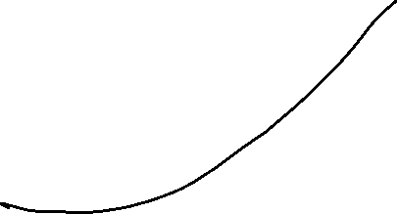


Slide 6
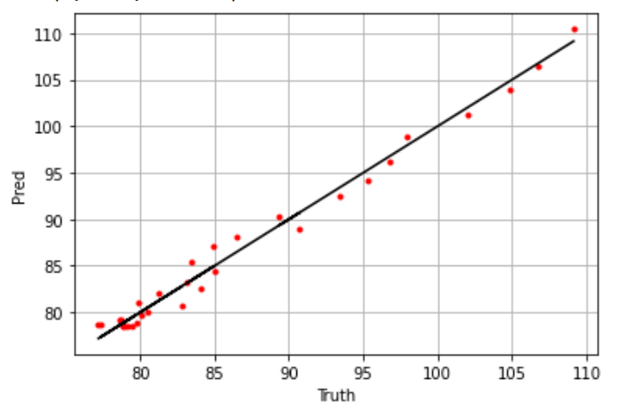







Slide 7
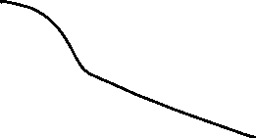










Exercise 2: Regression
As a member of Engineers Without Borders, you are working in a community that has contaminated drinking water. At t = 0, you add a disinfectant to a cistern that is contaminated with bacteria. You make the following measurements at several times thereafter (refer to data7_3.csv). If the water is safe to drink when the concentration, c falls below 5 #/100 mL, estimate the time at which the concentration will fall below this limit.

Slide 8
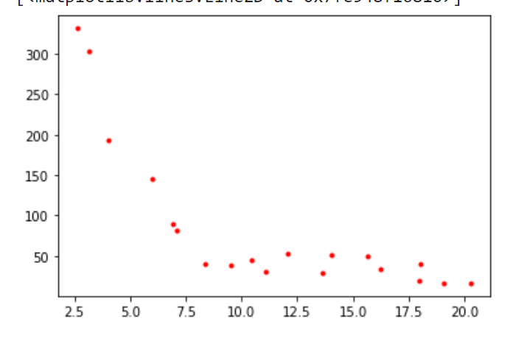




Slide 9
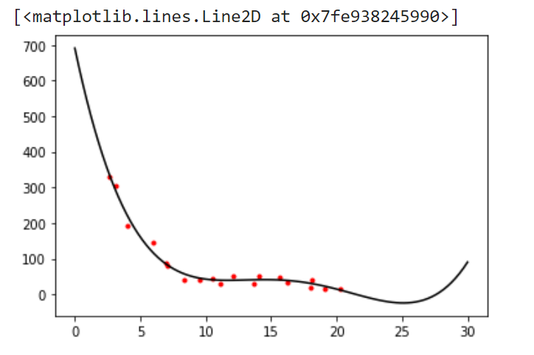

Slide 10


Case Study: Apply Lifecycle of Data science
Find Useful Insight based on the Used Car Data set as below
Link: https://www.kaggle.com/adityadesai13/used-car-dataset-ford-and-mercedes/tasks?taskId=1258

Slide 11
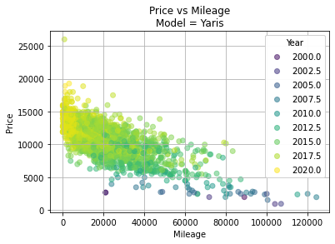

Case Study
Select Car by Manufacture, i.e.: Toyota
Filler by Model, i.e.: Yaris
Define parameters; mileage, year, and price
Use scatter plot to visualize Step 3
https://cmdlinetips.com/2018/02/how-to-subset-pandas-dataframe-based-on-values-of-a-column/

Slide 12
Statistical Thinking in Python

Slide 13

Basic Descriptive Statistics
df.method() | description
describe | Basic statistics (count, mean, std, min, quantiles, max)
min, max | Minimum and maximum values
mean, median, mode | Arithmetic average, median and mode
var, std | Variance and standard deviation
sem | Standard error of mean
skew | Sample skewness
kurt | kurtosis

Slide 14
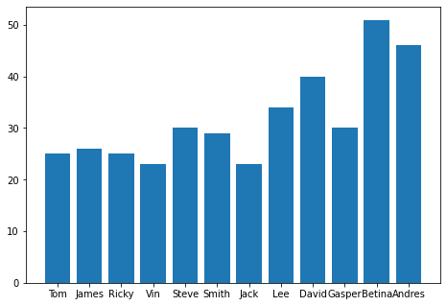
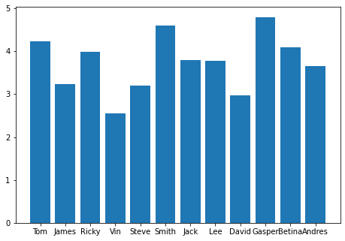
Exercise 1: Data Overview
Name | Age | Rating
0 Tom | 25 | 4.23
1 James | 26 | 3.24
2 Ricky | 25 | 3.98
3 Vin | 23 | 2.56
4 Steve | 30 | 3.20
5 Smith | 29 | 4.60
6 Jack | 23 | 3.80
7 Lee | 34 | 3.78
8 David | 40 | 2.98
9 Gasper | 30 | 4.80
10 Betina | 51 | 4.10
11 Andres | 46 | 3.65

Slide 15
Exercise 1: Descriptive Statistics
Name | Age | Rating
0 Tom | 25 | 4.23
1 James | 26 | 3.24
2 Ricky | 25 | 3.98
3 Vin | 23 | 2.56
4 Steve | 30 | 3.20
5 Smith | 29 | 4.60
6 Jack | 23 | 3.80
7 Lee | 34 | 3.78
8 David | 40 | 2.98
9 Gasper | 30 | 4.80
10 Betina | 51 | 4.10
11 Andres | 46 | 3.65
df.method()
describe
min, max
mean, median, mode
var, std
sem
skew
kurt

Slide 16
Basic statistical Analysis
statsmodel and scikit-learn - both have a number of function for statistical analysis
The first one is mostly used for regular analysis using R style formulas, while scikit-learn is more tailored for Machine Learning.
statsmodels:
linear regressions
ANOVA tests
hypothesis testings
many more ...
scikit-learn:
kmeans
support vector machines
random forests
many more ...

Slide 17

Library: statsmodels
statsmodels is a Python module that provides classes and functions for the estimation of many different statistical models, as well as for conducting statistical tests, and statistical data exploration.
import numpy as np
import statsmodels.api as sm
# Generate artificial data (2 regressors + constant)
X = np.random.random((100, 2))
X = sm.add_constant(X)
beta = [1, 0.1, 0.5]
e = np.random.random(100)
y = np.dot(X, beta) + e
# Fit regression model
results = sm.OLS(y, X).fit()
# Inspect the results
print(results.summary())

Slide 18
Regression with Two Predictor Variables
For two predictor variables, the general form of the multiple regression equation is:
Ŷ= b₁X₁ + b₂X₂ + a
The ability of the regression equation to accurately predict the Y values.

Slide 19
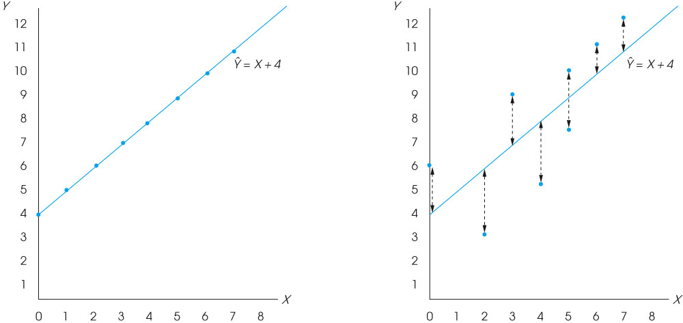
Notes:
Figure 17.5
(a) A scatter plot showing data points that perfectly fit the regression line defined by the equation Y ˆ = X + 4. Note that the correlation is r = +1.00. (b) A scatter plot for the data from Example 17.1. Notice that there is error between the actual data points and the predicted Y values of the regression line.

Slide 20
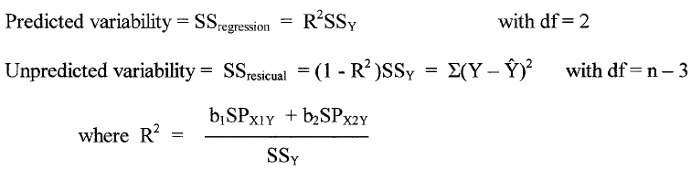
Regression with Two Predictor Variables (cont.)
As with linear regression, the unpredicted variability (SS and df) can be used to compute a standard error of estimate that measures the standard distance between the actual Y values and the predicted values.

Slide 21
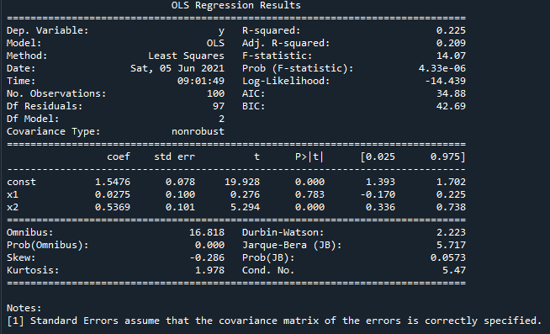



Library: statsmodels
Result

Slide 22
End

